Slide 1
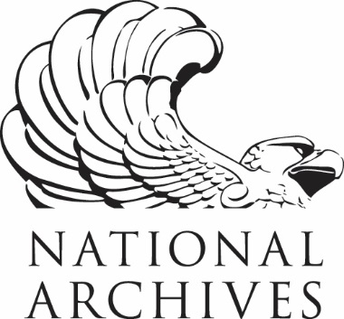
Welcome To the NARA - CoSA Joint Webinar! April 9, 2020
MPLP (More Product, Less Process) Projects at the National Archives and at the Wisconsin Historical Society
Content
Content
Content
Use the chat box at the right of the screen to tell us who you are, where you’re from, and who is participating with you today.
You can connect to the audio portion of today’s webinar through your phone line or through VoIP

Slide 2
Welcome
Meg Phillips, External Affairs Liaison
National Archives and Records Administration
Barbara Teague, Executive Director
Council of State Archivists

Slide 3
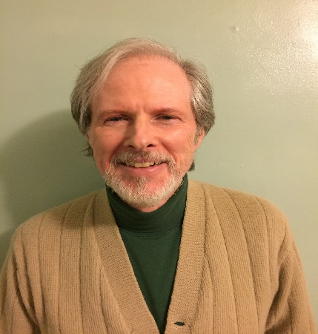
PRESENTERS
National Archives and Records Administration
Michael Moore, Director
Affiliated Archives Program
Wisconsin Historical Society
Abbie Norderhaug, Assistant State Archivist
Moderator:
Carrie Martin, Records Policy Planner
Louisiana State Archives
CoSA-NARA Webinar – April 9, 2020

Slide 4
Today’s agenda
Welcome
Processing with MPLP at the National Archives
MPLP at the Wisconsin Historical Society
Q and A
Announcements
CoSA-NARA Webinar – April 9, 2020

Slide 5
Processing with MPLP at the National Archives
Michael T. Moore
Research Services Processing Program Owner

Slide 6
Challenges:
OIG Audit, 2007– A large and growing backlog
Enormous Holdings: 2010- 3,537,381 cf
Over 100 employees carrying out processing
15 Custodial Units across country
New systems
Limits on increasing staff

Slide 7
Where we started:
“One size-fits all” Processing
A model of perfection
No systematic process for planning, tracking, or evaluating actions
Definitions of processing not consistent and outdated
No criteria for what was essential

Slide 8
2014 White Paper on “Highly Efficient Processing”
New direction:
Aim to provide access to all holdings
Always look for the “golden minimum.” “the least we can do to get the job done in a way that is adequate to user needs, now and in the future.”
Analyze the work necessary for every series and be flexible in the amount of work applied. (Do not expect a “one-size-fits-all” standard for arrangement, description, or preservation.).
Measure and compare processing rates to ensure processing is carried out efficiently.

Slide 9
The New Processing Model:
Definition of processing
Different levels of processing
Assessment, planning, and tracking
Balanced Actions based on characteristics of the records
Standards

Slide 10
NARA’s Processing Policy 2016
Policy: NARA processes records to provide physical and intellectual control over our permanent holdings. These actions are based upon the unique characteristics of the records. We process in order to effectively manage our records as valuable assets, protect them, make them more accessible, ensure that federal laws and policies are followed, and to preserve them for future use.
Definition: Records are processed at the point where a researcher can discover their existence (i.e., records have a description in the National Archives Catalog) and either have access to the original records or copies/digital surrogates promptly or have a prompt explanation of why we must withhold them.

Slide 11
Two Levels:
Basic Processing: actions are completed for a series to meet basic (essential) standards of physical and intellectual control
Augmented Processing: any work done beyond the basic level (usually prompted by specific needs or in response to the significance of records.

Slide 12
8 Standards for Basic Processing
Condition of Records Housing
Container labels
Arrangement
Access Restrictions
Disposition Status Verification
Physical Control (Recorded in HMS)
Intellectual Control (Catalog)
Adequate finding aids

Slide 13
Processing Manual FY17
Assessment: How to assess records for processing-- determining what is needed
How to apply basic standards
Quality Control
Augmented
Documentation
Current Table of Contents
I. Introduction
II. Levels of Processing
III. Assessment Procedures
IV. Standards for Basic Processing
V. Quality Assurance: Audit Procedure for Basic Processing
VI. Augmented Processing
Appendix 1. Archival Significance
Appendix 2. Guidance for Holdings Maintenance During Basic Processing
Appendix 3. Links to Resources
Appendix 4. Glossary of Terms
Appendix 5. NARA Analog Processing Policy

Slide 14
Improvements since 2017
Annually request feedback from staff to make improvements and create a revised Manual.
Quality Control Procedures
Augmented Processing
Improvements to the assessment process (originally a form it is now a part of HMS)
Training
Processing Rate Studies

Slide 15
Results?
 | Total Volume of Holdings | Holdings Processed | Processed | Total series | Series Processed
Sept 30, 2016 | 4,442,859 | 3,390,496 | 76.31%. | 288,771 | 213,838
Feb 29, 2020 | 4,785,517 | 4,243,354 | 88.67% | 297,705 | 238,334
Estimated FTE available for processing
Sept 30,2016 | 107.3
Feb 29 2020 | 84.8

Slide 16
More Product Less Process
Notes:
Hello, thanks for having me here today, a note of warning, I’m joining you all from home today so please excuse any background noise.
My name is Abbie Norderhaug, I’m the assistant state archivist at the Wisconsin Historical Society. I’ve been in this position since 2016, prior to that, I was the WHS’s public records accessioner and in that position coordinated the work that I’ll discuss here.

Slide 17
The Wisconsin Historical Society
Notes:
The WHS is an independent state agency that serves as the State of Wisconsin's State Archives, the North American History Library for the UW Madison,
The WHS receives records from over 50 state agencies, 71 of our 72 counties, and 1000s of municipalities. The amounts to about 1000 cubic feet of records per year. Handling this content are two full time staff members, one for state records and one for local records, and a team of work study students, and part time staff.
Those full time staff members I mentioned are also responsible for providing records management advice and training, traveling for field appraisals, and other work in addition to accessioning all this material. Given the small staff size, an MPLP style approach is the only way to make sure that our public records collections are accessible in a reasonable timeframe.

Slide 18
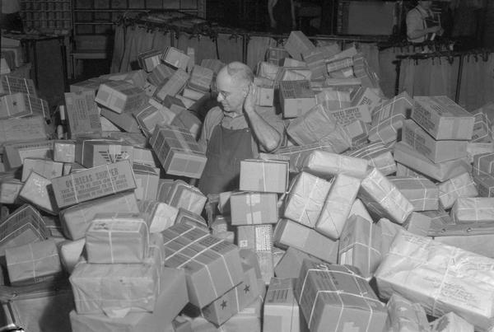
Processing History
Image ID 9939
Notes:
The WHS has been accepting public records since at least 1907, so as you can imagine, the intervening years have brought a number of different processing styles.
The earliest records are what we think of as fully processed, material arranged, in labeled folders and boxes with container lists. From this detailed treatment, collections moved to a status where they appeared processed, however, rather then creating finding aids detailed information about content was added to box labels. As you might imagine, this works great if you have time to go into the stacks and read the labels of a collection until you find the content you need.
Need to look at Carolyn’s paper for detailed here also check petition grant project application and Helmut’s MAC article? SAA Article??
Its important to note, that different types of collections have different level of process standards. Although we’ve adopted MPLP standards for our descriptive standards, they are not used for all collections.
A number of local government record collections are not prepared for access using MPLP approaches. They are traditionally processed.
There are certain state record collections that include things like PII or confidential information which are also not candidates for an MPLP approach.

Slide 19
WHS Minimal Accessioning Standards
 | FULL PROCESSING | WHS ACCESSIONING
ARRANGEMENT
Place unfoldered material into folders | Yes | Yes
Arrange folders into series | Yes | Typically No – exceptions may be made if the size/complexity of collection warrant
Arrange folders within series | Yes | IF series have been created, then Yes
Arrange items within folders | Yes | No
Notes:
As best as WHS oral history remembers, these minimal accessioning standards were developed in the early 1990s and was probably in response to the collecting hay days of the 60's-80's in which so much was being brought through the doors that collection management couldn't keep up with it all.
It was around this time that the online catalog raised the need for some minimum level of access to a collection. All of those unprocessed collections were basically unavailable prior to the advent of the catalog but once they were "findable" we had to be able to offer some better access points and so developed the "minimum accessioning standards;" abstract and contents list to the folder level for every new collection with more than one container.

Slide 20
WHS Minimal Accessioning Standards
DESCRIPTION LEVEL
Collection/Record Group | Yes | Yes
Series | Yes | Typically No – exceptions may be made if the size/complexity of collection warrant
Folders | Yes | Listed by folder title in container list
Items | May list or describe | No, with the exception of audio and video recordings and film which are listed individually by title in the container list with a brief summary in the abstract of all A/V materials

Slide 21
WHS Minimal Accessioning Standards
PRESERVATION
Refolder | Yes | Only if original folders are brittle, dirty, illegible or poorly identified, or otherwise damaged
Remove fasteners | Yes | No
Segregate and/or photocopy clippings, carbons, onionskins | Yes | No – may photocopy if there are only a small number of brittle/acidic documents
Segregate and/or sleeve photos | Yes | Yes, if contextual information is not lost by segregation – typically do not sleeve unless fragile
Encapsulate or mend torn documents | Yes | No
Interleave scrapbooks and photo albums | Yes | No

Slide 22
The Project
Move 30,000 cubic feet of public records to a new building
Ensure that every collection moved has improved access:
Each accession needs a description
Each accession over 1 cubic foot needs a box and folder list
All other formats associated with the collection must also have access improved
Notes:
After a number of years of requesting, the WHS received funding for a new storage building. After funding was secured, we began thinking about the move of our collection and the issues associated with providing access to a collection where nearly 50% would be stored offsite. One thing we quickly realized was that to make the most efficient use of our new space, the building needed to be managed more like warehouse then the way we’d been managing our archives stacks. Methods of access that involved someone reading box labels to find a particular file weren’t going to be feasible in our new set up.
Additionally, to save wear and tear both on collections and on staff, we wanted to minimize the number of boxes that were brought to our reading room. We of course wanted to bring things that researchers need and want, but we wanted to avoid situations where we transported lots of boxes for a single folder or two.

Slide 23
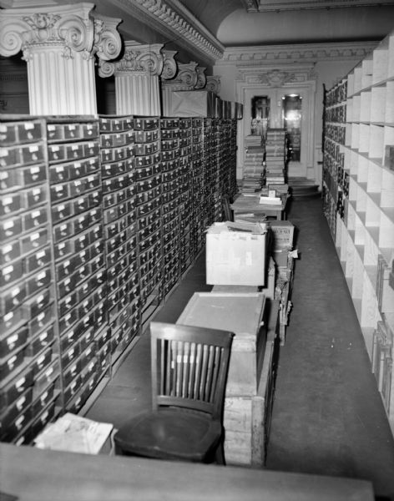
Selecting Collections
Use patterns
Large collections of similar content
Location
Appraisal needed
WHS ID 47898
Notes:
When we started this project, the first step was evaluating collections for those which we would move. This project was funded by “special” money that was to pay for preparation projects. Therefore, project staff could only work on collections that would eventually be moved. We created a database of potential collections which contained information about each series and accession that we proposed to move, and decided at the outset.
If a collection was going to move, the entire collection would be moved including any processed portion and all accessions.
The next thing we looked at was use patterns. If call slips determined that a collection was paged regularly, of if there was antidotal evidence that a collection was regularly used, it was not going to move.
Then we started looking at collection types. The ideal collection for our MPLP methods were large collections of similar content. Think of things like controlled correspondence that tends to be arranged by control number or alphabetically. Long runs of alpha subject files were tempting, but only if we could commit to listing each folder title (unless they were straight alpha files).

Slide 24
Collection Task Lists
TASKS | EXPLANATION | TASK NEEDED? | WHICH ACCESSIONS? | DONE
Pull boxes and Review Containers | If new list needs to be created or some physical activity needs to be undertaken, pull the boxes. If the contents seem to be in disarray or need further attention see your supervisor.
Folder loose materials | When boxes contain material not in any folders, folder it for preservation and descriptions reasons. Label the folder/s, even if the label will be "general material". Do not use "loose" or "unlabeled" as descriptive titles.
Quick arrangement of materials | When handling and describing small collections (under 10 c.f. or so), it may be fairly obvious when like materials can be brought together (e.g. correspondence or subject files). If this is the case and arranging the materials will result in simplifying the container list and other descriptive work, go ahead and arrange the material into series.
Consolidate and rebox | If boxes are not filled to capacity they should be consolidated. Note the change in collection size on the ArCat record you give Abbie.
Volumes | Loose volumes cannot be left on the shelf. Volumes must either be: Boxed in appropriate sized flat boxes Shrink wrapped Regardless of container, volumes must appear on the container list
Needs new boxes | The boxes are not standard size or are damaged. Also may pertain to volumes which need to be boxed at this time.
Create list | A new box and folder list will need to be created for accessions which have more than 1 physical unit. Write out ALL abbreviations and acronyms.
Create list | The accession needs a list which provides details about the range (usually alphabetical or chronological) in the box, each folder does not need to be listed.
Notes:
To manage this process we created collection task lists that summarized the potential work that a collection might need. This way, staff could review collections, determine the level of work necessary, and assign collections to the appropriate project staff. Because collection size varied so greatly and we had a variety of part time staff, we needed to manage who got certain types of collections.
The task lists allowed the staff running the project a uniform way to communicate with project staff, and

Slide 25
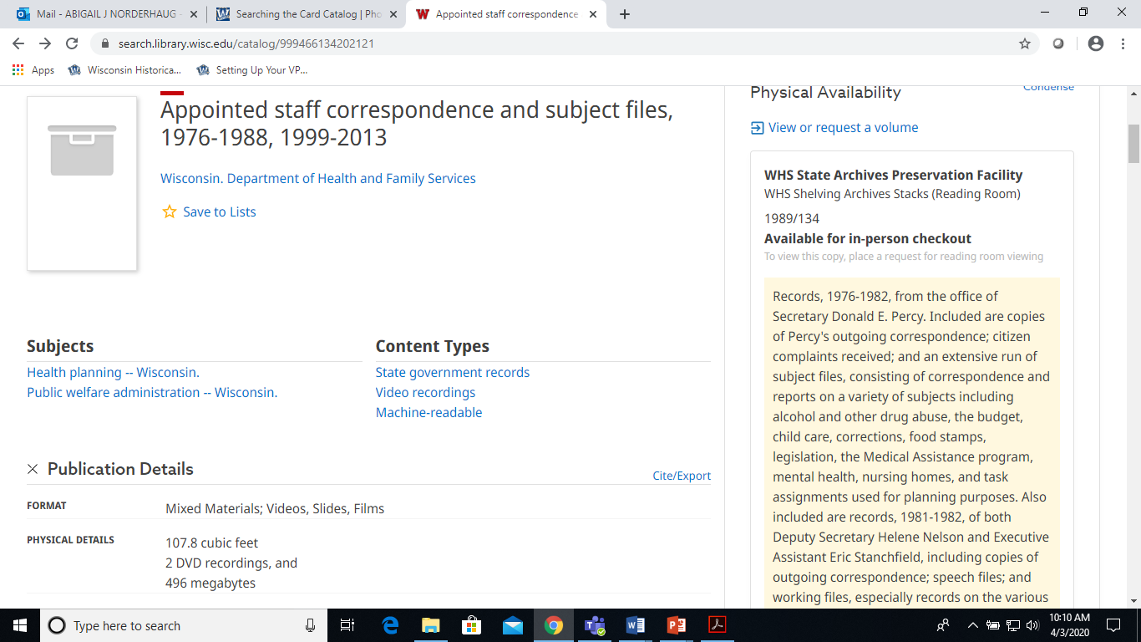
Outcomes
1. Improved catalog records
Notes:
The catalog record you see on screen here includes 183 cubic feet described in 12 separate accessions like you see here.

Slide 26
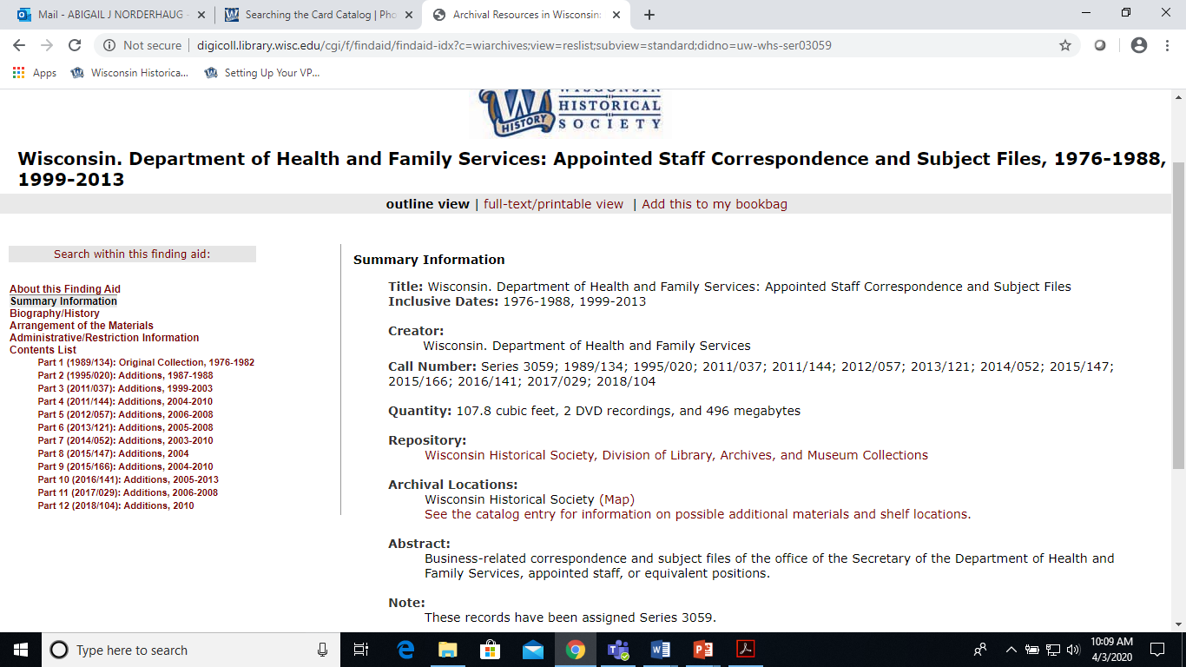
Outcomes
2. EAD Finding Aid

Slide 27
Outcomes
3. The process continues…
All new accessions are brought up the minimum accessioning standards upon receipt and container lists are added to EAD
When there is time, container lists we have in MS Word are marked up for EAD.
Collections that need improved description are tracked so they can be worked on when there is time.

Slide 28
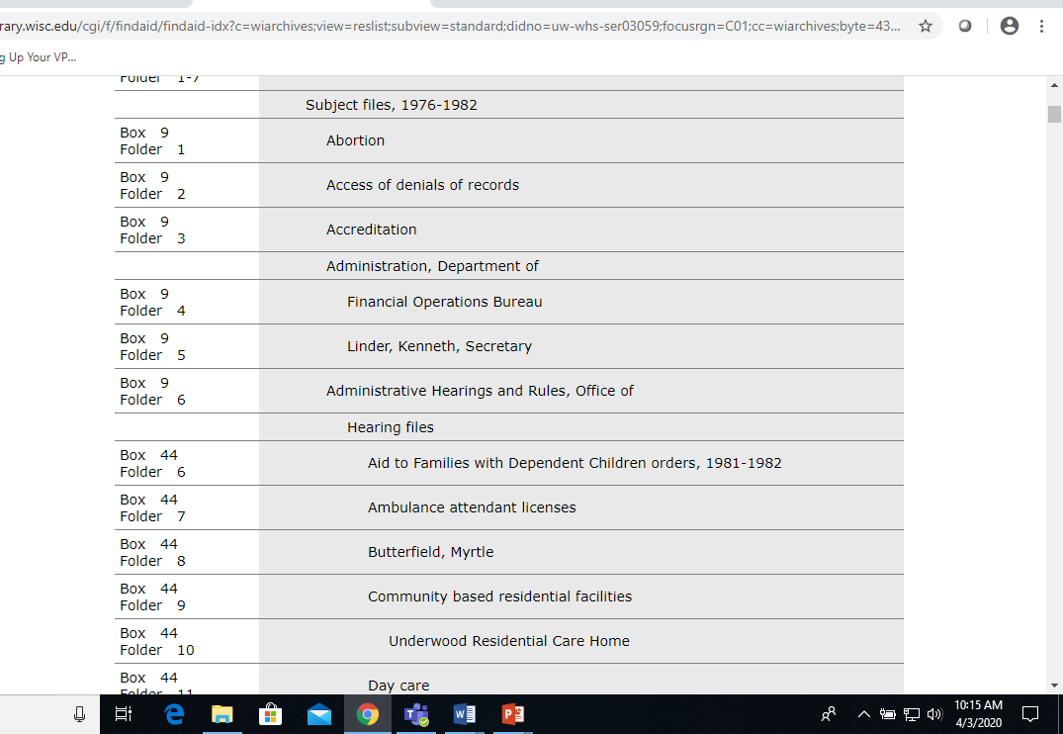
Lessons Learned: What Worked
MPLP
Intellectual arrangement vs. physical arrangement
Selectively combining accessions
Accession number stamp
The tracking material
Forms
Templates
Notes:
Overall, the entire project worked as we anticipated it would, by planning up front about what collections we would using MPLP to quickly make available. There were times when work was started on a collection, and then we determined that it needed more work then we were able to do at that time. In these instances, we either determined that the collection would be set aside or looked at the benefits of the additional work.
Given the number of collections we looked at, there were times where space and/or staff constraints made it impossible to physically rearrange a collection. In these instances, we determined that rather then move around material, we’d represent its correct location on a finding aid, but keep the boxes numerically out of order.

Slide 29
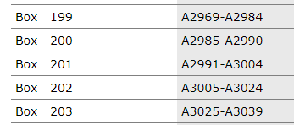
Lessons Learned: What Didn’t Work
Forgoing folder numbers
Spitting a single series between staff members
Using descriptions written on boxes
Notes:
1. This first one is obvious, since we carefully selected collections for which MPLP would be appropriate, we considered a few different things that could save time. The first was not labeling folders.
Typically, we write the accession number and box and folder numbers on each folder. Writing this information was found to add 15 minutes/box. Processing staff decided to leave off this information to speed our processes.
However, this information makes the job of public services staff much easier. So, after working on a few collections where we left off this information, the feedback from reference staff was that leaving off this information made their jobs much harder. In the end, saving 15 minutes wasn’t worth the long term issues that the savings were creating.
2. Because we were describing individual accessions separately, rather then entire series, we tried having multiple employees work on a single series. Staff simply didn’t like that approach. They preferred being responsible for the whole series. This seemed to be the preference because staff was able to see the accomplishment of finishing an complete series at a time. Splitting things up sometimes also made it hard to see when two accessions should obviously be combined (subject files where an alpha-run was unintentionally spit up.
3. For a number of collections at offsite that had been “processed” by past staff, we simply copied descriptive information from the boxes into our EAD finding aids. We trusted our predecessors and didn’t go into boxes looking for things or verifying the information. This was mostly ok, however we’ve since found instances where these brief descriptions are not enough to provide access to the boxes.
4.

Slide 30
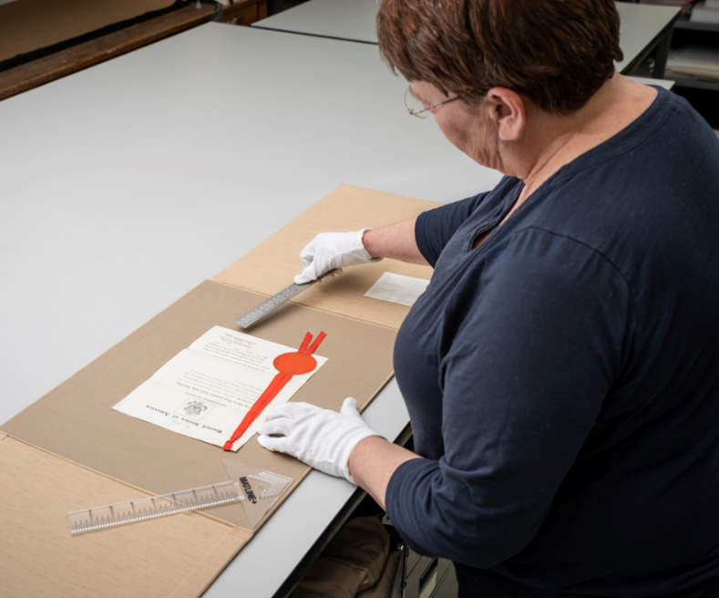
Lessons Learned
Not all collections can be described this way
If you describe things, people want to see them
Never open the boxes
The entire doesn’t need to move
Impact on other program areas
And, most importantly, we’ve
got some good stuff
Notes:
This first one is obvious, since we carefully selected collections for which MPLP would be appropriate, we considered a few different things that could save time. The first was not labeling folders.
Typically, we write the accession number and box and folder numbers on each folder. Writing this information was found to add 15 minutes/box. Processing staff decided to leave off this information to speed our processes.
However, this information makes the job of public services staff much easier. So, after working on a few collections where we left off this information, the feedback from reference staff was that leaving off this information made their jobs much harder. In the end, saving 15 minutes wasn’t worth the long term issues that the savings were creating.

Slide 32
Questions?
Abbie Norderhaug
Assistant State Archivist
abbie.norderhaug@wisconsinhistory.org
(608) 264-6478

Slide 34
Questions and comments

Slide 35
Stay connected & informed
CoSA Website http://www.statearchivists.org
CoSA Resource Center https://www.statearchivists.org/resource-center/resource-library/
CoSA Twitter Handle: @StateArchivists
CoSA Facebook Page: www.facebook.com/CouncilOfStateArchivists
CoSA-NARA webinar – April 9, 2020

Slide 36
Stay connected & informed
NARA Website http://archives.gov
NARA Twitter Handle: @USNatArchives
NARA Facebook Page: www.facebook.com/usnationalarchives
NARA Social Media Directory
http://www.archives.gov/social-media
CoSA-NARA webinar – April 9, 2020

Slide 37
Webinar evaluation
We really do appreciate your feedback!
After you exit the webinar, you will automatically be taken to an online webinar evaluation. Please take a couple of minutes to complete the survey and help us plan future webinars.
CoSA-NARA webinar – April 9, 2020

