Slide 1
CoSA-NARA Webinar Preserving Audiovisual Materials
presented by the
National Archives and Records Administration
and the
Pennsylvania State Archives October 8, 2020 I 3 pm Eastern

Slide 2
Welcome and Agenda
Welcome
Today’s Agenda
Introductions
Presentations
Q and A
Announcements

Slide 3
Speakers
MODERATOR
Meg Phillips, External Affairs Liaison, NARA
PRESENTERS
Dan Rooney, Director of the Special Media Records Division, NARA
Wes Decker, Archivist, Pennsylvania State Archives
Marie Valigorsky, Archivist, Pennsylvania State Archives

Slide 4
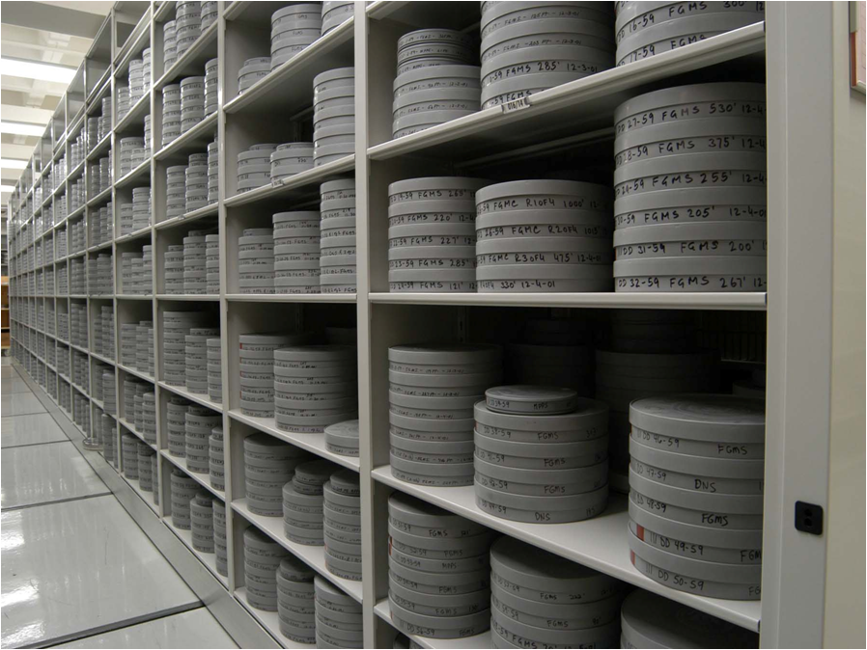
Moving Image and Sound Branch
Special Media Records Division
College Park, MD

Slide 5
National Archives and Records administration (NARA)
Established as U.S. government federal agency in 1934
Mission is to preserve and make available the permanently valuable records of the federal government, as well as donated materials collections
Provide records management services to federal agencies
Provide Public Access to collections
Administer archival holdings at 44 sites across the U.S.
Administer Presidential Library System

Slide 6
MOVING IMAGE AND RECORDED SOUND COLLECTIONS
Collecting of Motion Pictures and Sound Recordings date to the establishment of NARA
Primarily holdings from Executive Branch federal agencies, Congress and the Courts
Large volume of Donated Materials Collections
520,400 reels of motion picture film
312,066 sound recordings
170,925 video recordings and rapidly growing
700+ TB Born digital/digitized holdings
Associated Textual Records

Slide 7
MOVING IMAGE AND RECORDED SOUND COLLECTIONS
Motion Picture Film:
8mm, 9.5mm, 16mm, 35mm, 65mm, 70mm
Negative, positive, reversal, sound, silent
Video Formats:
Cassettes (Betacam, VHS, U-matic, Digital Betacam, Hi-8, DVC Pro, DVC ProHD, HDCAMSR)
Open Reel (2” Quad, 1” Open Reel Type A, C, 1 / 2” EIAJ open Reel
Optical Discs (DVD, Blu-Ray)
Sound Formats:
Disc Recordings (lacquers, shellac, vinyl, uncoated aluminum, memovox)
Open Reel Audio Tape
Cassettes, microcassettes
Dictation Belts and other Grooved Media
Optical Discs (CD, CD-R)

Slide 8
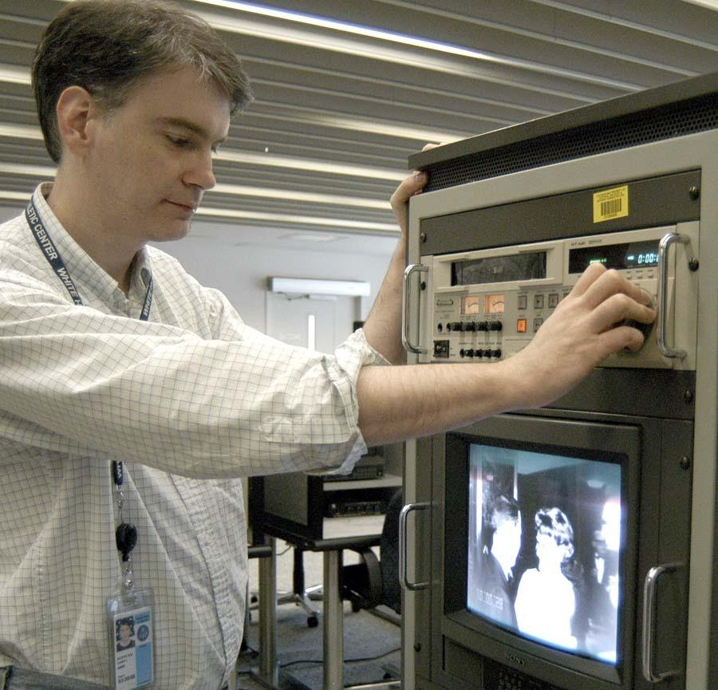
MOVING IMAGE AND SOUND RESEARCH AT NARA
Reference Staff Operates Motion Picture and Recorded Sound Research Room in College Park
Reference Collections Served in a Variety of Formats: Video Tape, DVD, Film Prints, Digital Files
Self Service and Records Retrieval
Consultation Services and Numerous Finding Aids

Slide 9
MOVING IMAGE AND SOUND RESEARCH AT NARA
2010 - 2018: Emphasized digital transition of research room operations
Annual work plans emphasized two approaches:
Identify and prioritize legacy reference collection for digitization
Phase out and replace analog reference service model with digital reference service model
Reduced analog playback workstations
Reduced variety of analog copy types served
Transitioned to digital delivery
onsite and offsite models

Slide 10
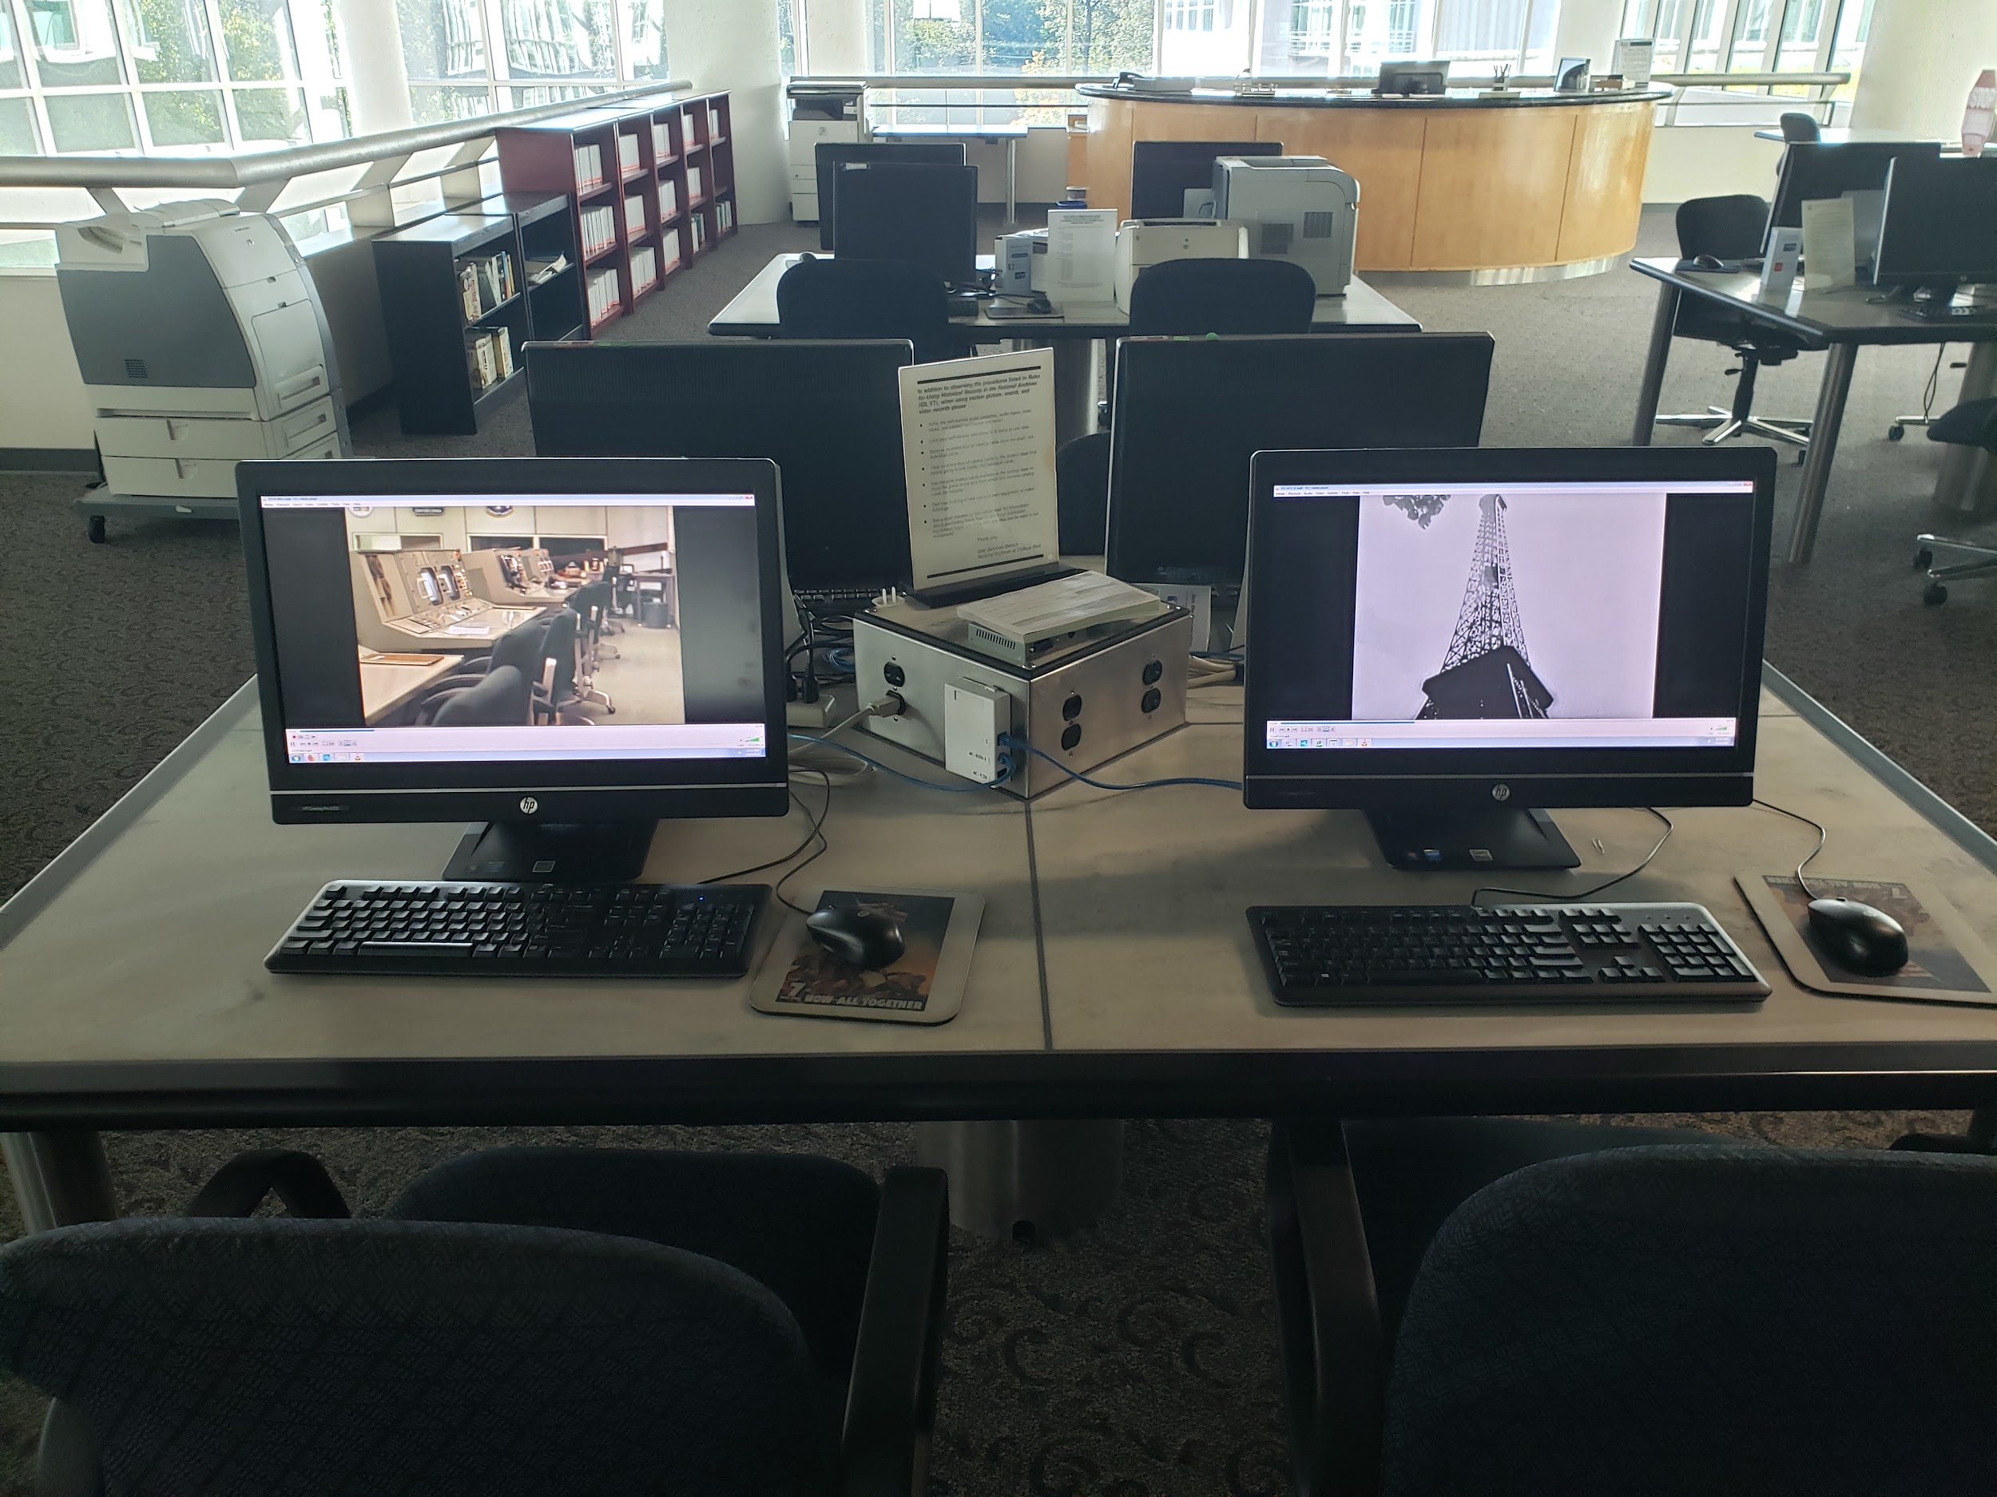
MOVING IMAGE AND SOUND RESEARCH AT NARA
Digital Reference File Deliverables:
Digital Video: Digital Audio:
Data Format: Container: MPEG-4 MPEG-1 Audio Layer 3 (aka MP3) Bitrate: ~2.1 Mbps 128kbps (mono) or 256kbps (stereo)
Video frame size: 720 x 480 non-square pixels Typical file size 128 Kbps: ~ .96 MB/minute
Aspect ratio: 4:3 or 0.57 GB/hour
Video codec: Advanced Video Codec (avc1) 256 Kbps: ~ 1.9 MB/ minute or .113 GB/hour
Video bitrate: ~2.0 Mbps
Audio channels: 2 (stereo L R)
Audio bitrate: 192 Kbps
Audio mode: CBR
Audio codec: Advanced Audio Codec (AAC)
Audio sample rate: 48 KHz
Audio sample size: 16 bit
Typical file size: ~15.67 MB/minute or .940 GB/hour

Slide 11
Digitization Inputs
Federal Agency Requests
Legacy Reference Media Replacement
Annual Work Plan by Fiscal Year
Metadata Projects
Scanning/
Reformatting Projects
Catalog Upload/QC projects
Technical QC and File Management Projects
Researcher Requests
Planned Digital Preservation Projects
Presidential Libraries
Planned Digital Access Projects/Digitization Partnerships
Exhibit / Screening Requests
Staff Archival Processing support

Slide 12
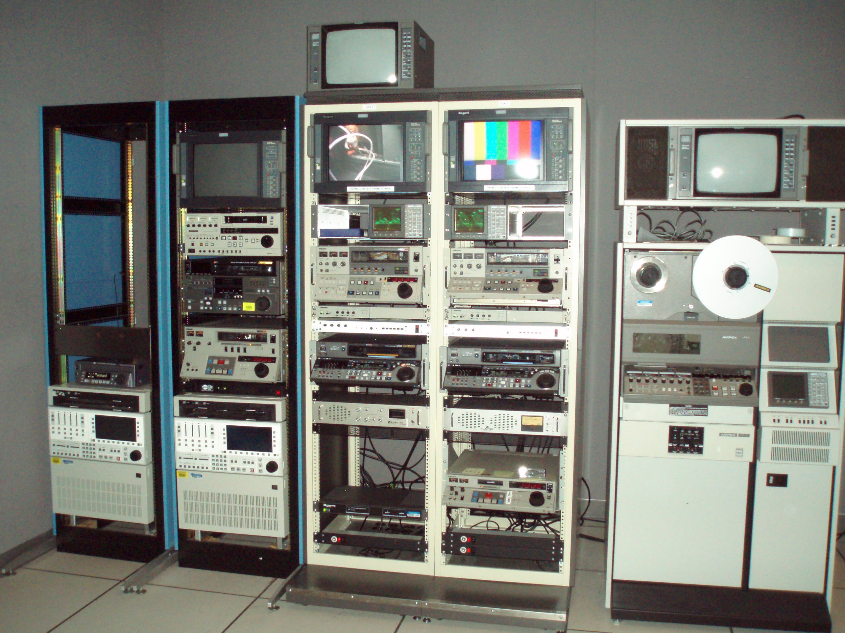
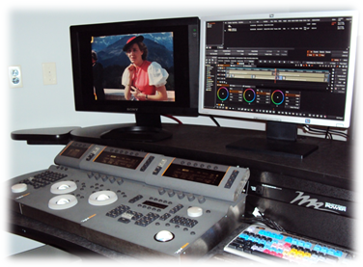
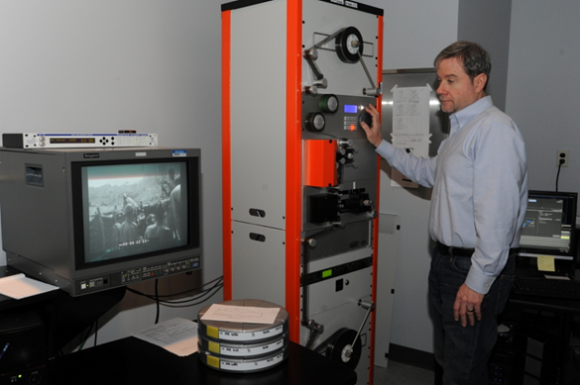
MOTION PICTURE AND A/V PRESERVATION LABS

Slide 13
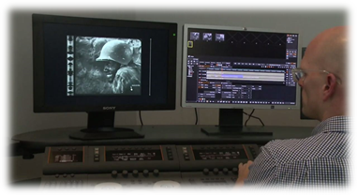
MOTION PICTURE AND A/V PRESERVATION LABS
Researcher Requests:
Provide digitization support for onsite reference viewing/listening for holdings which NARA does not have a suitable copy to provide for public access
Comprises the vast majority of digitization requests for non-planned projects
Film scanning comprises greatest number of public requests over video and audio

Slide 14
MOTION PICTURE AND A/V PRESERVATION LABS
Systematic preservation projects by series or collection
Audio and Video Formats at risk, of highest use, or with limited/expensive playback options
Determined in consultation between archival unit and labs
Digitize to preservation file spec and create derivatives for access
Collaborate with archival unit on metadata tracking, item/content verification/pulling and refiling process

Slide 15
MOTION PICTURE AND A/V PRESERVATION LABS
Systematic access projects by series or collection
To retire and replace failing legacy media used as reference copies
To increase access to high use holdings for researchers
To increase online access in the NARA catalog
To support specialized projects from another office (eg, exhibits or public programs)

Slide 16
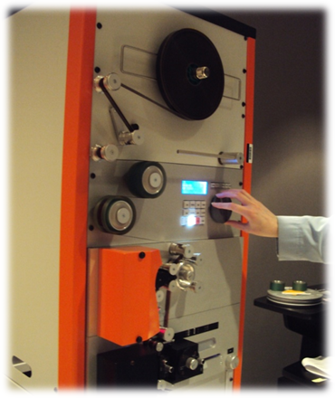
Digital preservation file workflows
Digitized Film:
DPX (Digital Picture Exchange) as defined by SMPTE 268M-1994
Uncompressed
Version 1
Bit Depth: 10 Bit
Resolution: 4K (4096x3112)
Color space: 4:4:4
Color model: RGB
Log Byte order: Big endian
Typical file size: ~ 68 GB/minute or 4 TB/hour
Audio Data (if present):
Encoded to Linear Pulse Code Modulation (LPCM)
Sampling frequency: 96 kHz
Bit depth: 24
Sound field: mono or dual mono
Typical file size: Mono: ~ 17.28 MB/minute or 1 GB/hour; Stereo: 134.5 MB/minute or 2 GB/hour
Typical Derivatives may include: HD DPX, SD-MPEG-2, MPEG-4

Slide 17
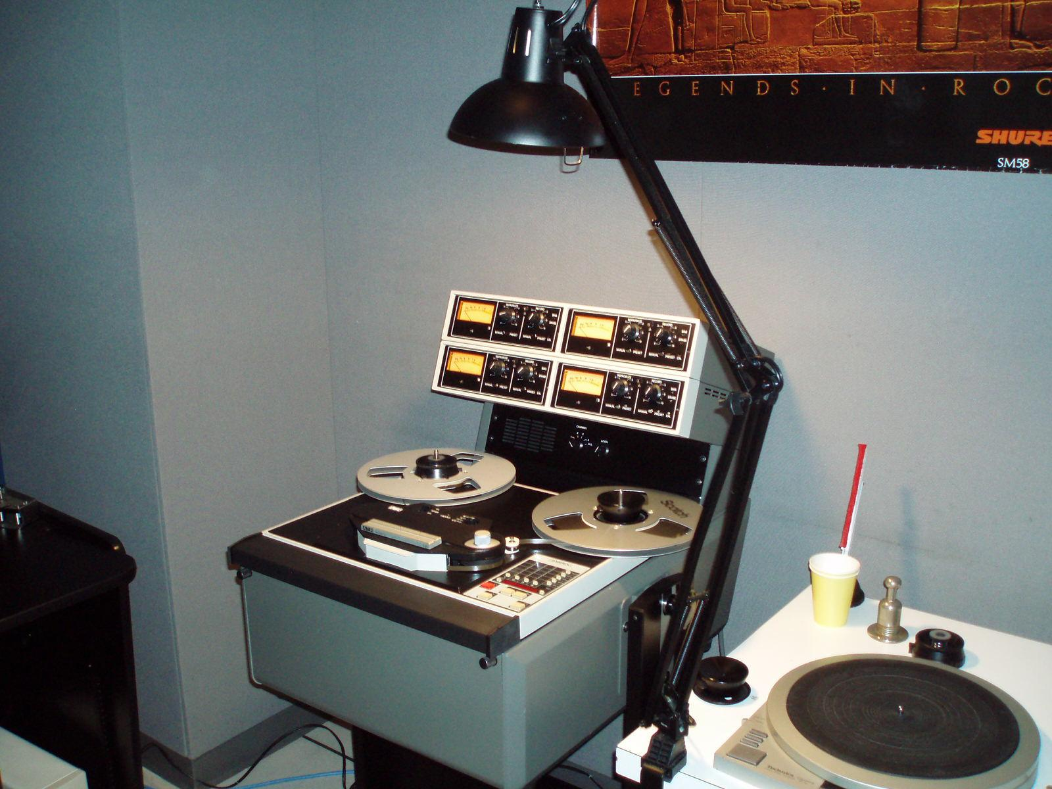
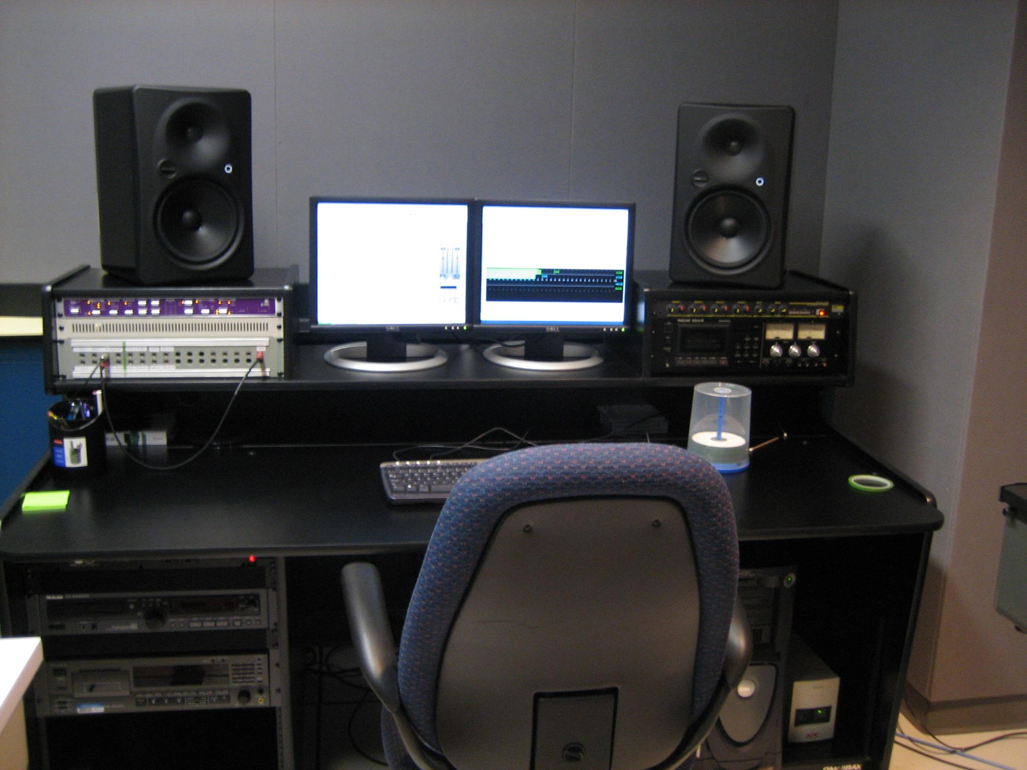
Digital preservation file workflows
Digital Audio:
Broadcast WAV (.wav) as defined by
The European Broadcasting Union in document Tech 3285
Uncompressed
Version: 1
Capture Information
Encoded to Linear Pulse Code Modulation (LPCM)
Sampling frequency: 96 kHz
Bit depth: 24
Sound field: as in original recording
Byte order: Little endian
Typical file size Mono: ~ 17.28 MB/minute or 1 GB/hour
Stereo: ~ 134.5 MB/minute or 2 GB/hour
MP3 Derivatives Listed above is file spec for reference deliverables - onsite and in the NARA Catalog

Slide 18
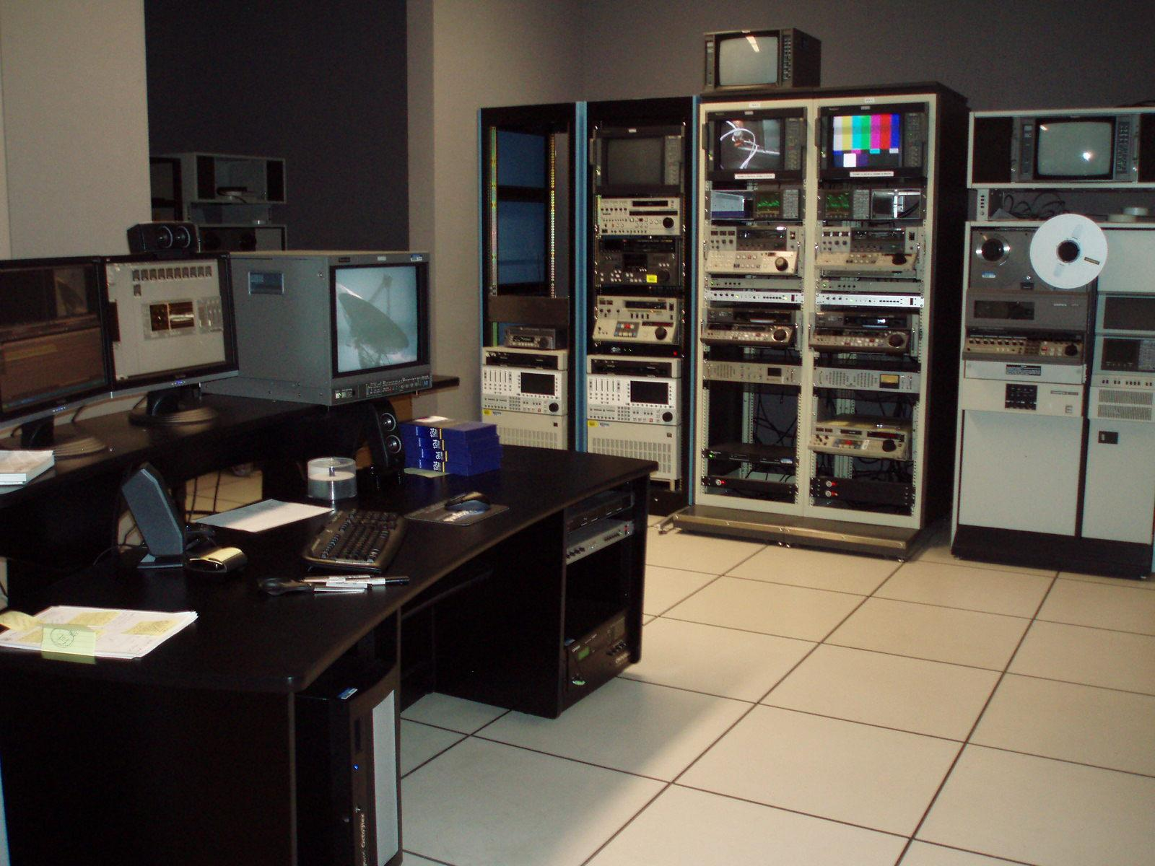
Digital preservation file workflows
Digital Video:
AVI (Audio Video Interleaved)
Target Total Bitrate: ~228 Mbps
Timecode: Source LTC/VITC
Frame size: 720x486
Video codec type: Uncompressed
Video codec: v210
Video bit depth: 10 bit
Video frame rate: 29.97 fps
Chroma subsampling: 4:2:2
Interlaced scan
Audio channels: 4 discrete (2 AES pairs)
Audio codec: PCM
Audio sample rate: 48 KHz
Audio sample size: 24 bit
Typical file size: ~589 MB/minute or 95.37GB/hour
Typical Derivatives include MPEG-2 50mb/s (Reproduction)
MPEG-4 ~2 mb/s (Reference)

Slide 19
NARA CATALOG - ITEM LEVEL DESCRIPTION FOR A/V RECORDS
Sample Project:
Systematic Film Scanning of U.S. Army World War I Historical Collection
5 year project to digitize all films and associated textual records
Update legacy catalog records
Transcription of textual files in catalog during telework

Slide 20
NARA RESOURCES FOR MOVING IMAGE AND SOUND COLLECTIONS
Moving image/audio reference requests can be sent to: mopix@nara.gov
NARA Moving image and Recorded Sound Website:
www.archives.gov/research/motion-pictures
Unwritten Record Blog: unwritten-record.blogs.archives.gov Nara Catalog
catalog.archives.gov
DAN ROONEY,
DIRECTOR, SPECIAL MEDIA RECORDS DIVISION
daniel.rooney@nara.gov

Slide 21
Digitizing Video Tapes at the Pennsylvania State Archives Wesley Decker Archivist

Slide 22
What the PA State Archives Can Digitize
Common Formats
¾ inch U-matic Tapes
Betacam Tapes
SP
SX
Digital
VHS Tapes
Most of the tape decks and accessory equipment were obtained through our partnership with Commonwealth Media Services. A few tape decks were already in-house.

Slide 23
What the PA State Archives Can’t Digitize
Common Formats
8 mm
16 mm
Need to send these reels to an outside vendor for digitization.

Slide 24
¾ Inch U-matic Tapes

Slide 25
¾ inch U-matic Tape Decks
Sony VO-9600

Slide 26
¾ inch U-matic Tape Decks
Sony VO-5850

Slide 27
Betacam Tapes
Betacam SP

Slide 28
Betacam Tapes
Betacam SX

Slide 29
Betacam Tapes
Digital Betacam

Slide 30
Betacam Tape Decks
Sony DNW-A75

Slide 31
Betacam Tape Decks
Sony DVW-A500

Slide 32
Betacam Tape Decks
Sony MSW-M2000

Slide 33
VHS Tapes

Slide 34
VHS Tape Decks
Sony SVO-1630

Slide 35
VHS Tape Decks
Sony SVO-5800

Slide 36
Digitization Process: Accessories
iMacs
Blackmagic Studio Videohub Router
Blackmagic H.264 Pro Recorder
Blackmagic Mini Converter Analog to SDI (U-matic and VHS)
Time Base Corrector (U-matic and VHS)

Slide 37
Digitization Process: Accessories
iMacs

Slide 38
Digitization Process: Accessories
Blackmagic Studio Videohub Router

Slide 39
Digitization Process: Accessories
Blackmagic H.264 Pro Recorder

Slide 40
Digitization Process: Accessories
Blackmagic Mini Converter Analog to SDI (U-matic and VHS)

Slide 41
Digitization Process: Accessories
Time Base Corrector (U-matic and VHS)

Slide 42
Digitization Process: Applications
Blackmagic Studio Videohub
Blackmagic Media Express
QuickTime
Adobe Premiere Pro

Slide 43
Digitization Process: Applications
Blackmagic Studio Videohub

Slide 44
Digitization Process: Applications
Blackmagic Media Express

Slide 45
Digitization Process: Applications
QuickTime

Slide 46
Digitization Process: Applications
Adobe Premiere Pro

Slide 47
Post-Digitization Processing: VideoBank Digital Asset Management System
Maintained in a partnership with VideoBank and Commonwealth Media Services
VideoBank houses our digitized audio and videos.
MOV file is uploaded into VideoBank through our own application “PHMC Archive”
M4V access file is created during the upload.
Descriptive Metadata
Examples: Series Number, Event, Date, Description, City, County, State, County, Administration, Agency, Individuals Represented, Keywords, Length, Format

Slide 48
Post-Digitization Processing: VideoBank Digital Asset Management System

Slide 49
Post-Digitization Processing: VideoBank Digital Asset Management System

Slide 50
Post-Digitization Processing: VideoBank Digital Asset Management System

Slide 51
Post-Digitization Processing: VideoBank Digital Asset Management System

Slide 52
Post-Digitization Processing: VideoBank Digital Asset Management System

Slide 53
Closing Advice
Partnerships are Important
Attention to Detail
Videos
Descriptive Metadata

Slide 54
Contact
Wesley Decker
Email: wedecker@pa.gov

Slide 55
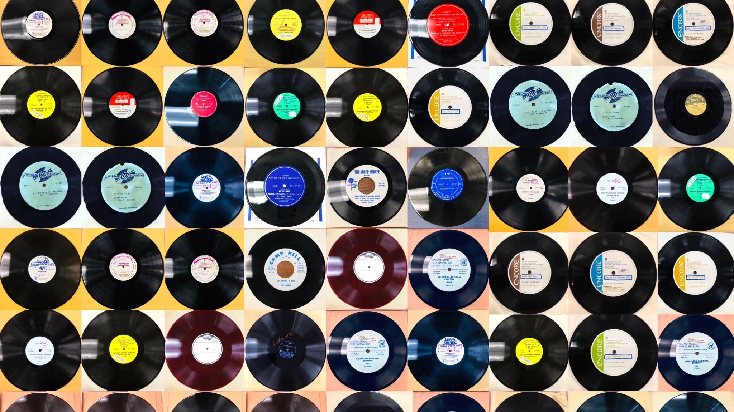
Audiovisual Preservation
Analog Audio Media
Marie Valigorsky
Archivist

Slide 56
Introduction
Identification & Prioritization of Media for Digitization
Assessment of Physical Media
Analog Audio Formats:
Audio Tape Reels (magnetic tape)
Audio Cassette Tapes (magnetic tape)
Vinyl Records
Digitization:
Equipment & Software
Troubleshooting and Tape Repair
Ingesting and Processing Assets with Descriptive Metadata

Slide 57
Identification of media in collections
Inventory of media in collections
PA State Archives has over 80 Record Groups (Government Records), and over 500 Manuscript Groups (Non-government Records)
Inventory includes:
Record title/description
Record Group or Manuscript Group Series number
Container’s description, location and barcode number
Media Type format: Size, Speed, Length
Generation; Copyright or Confidential

Slide 58
Prioritizing media for digitization
Magnetic tape degradation - tape reels and cassettes
Sticky shed syndrome, mold, vinegar syndrome
Vinyl records - stable media format
Storage - store all analog audio formats vertically

Slide 59
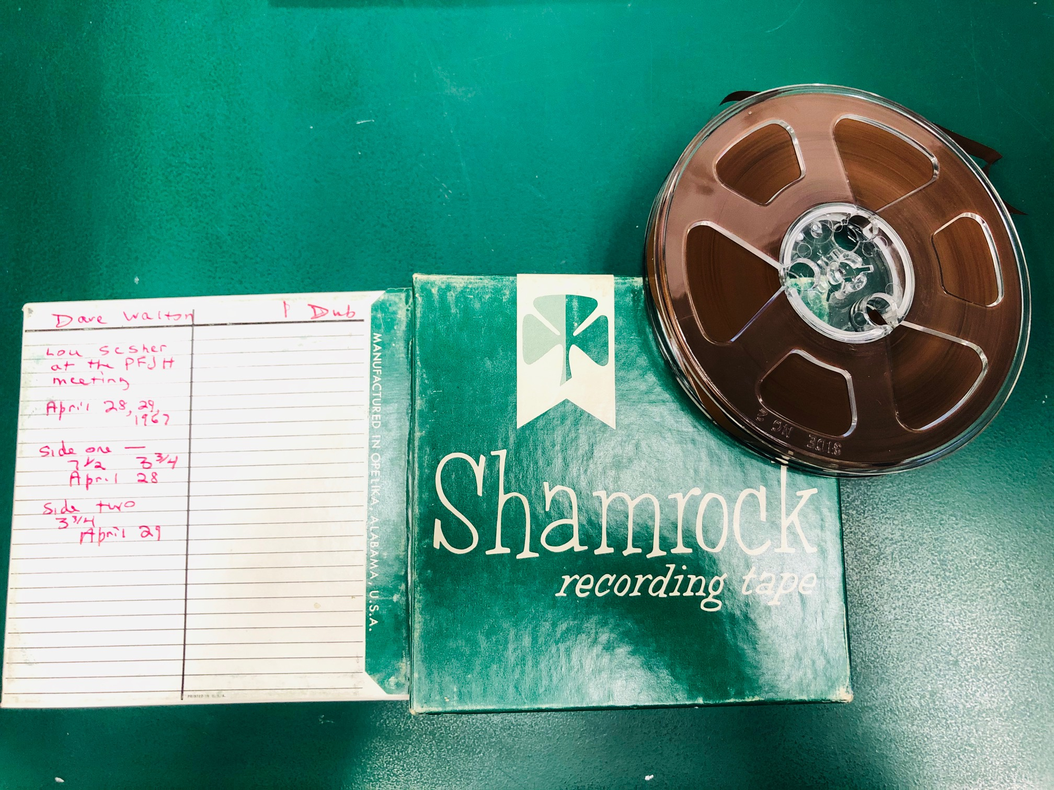
Assessment of audio media
Assess and inventory the type and quantity of audio media in containers
Content, date, speed, length, and other details about the recording

Slide 60
Reel-to-reel audio tape Oral History interview with Lou Sesher at the PFJH Meeting
Oral History interview conducted by Dave Walton with interviewee Lou Sesher on April 28-29, 1967
Side 1: Tape speed starts at 7.5 IPS and changes to 3.75 IPS
Side 2: Tape speed is recorded at 3.75 IPS
Dates, Content, and Speed of tape are specified
“1 Dub”

Slide 61
Audio cassette tapes
Oral history interview: Corinne Krause's interview with former Governor Milton Shapp on February 12, 1979
(Milton Shapp’s copy of the interview)
Bicentennial Speeches at Independence Hall Side 1 : Milton Shapp’s copy

Slide 62
Vinyl records, LP’s, phonographs

Slide 63
Record Group 13.204
Pennsylvania Historical and Museum Commission’s Division of Pennsylvania Folklore, Audio Records,
1946-1950

Slide 64
“Jorlai” Record Player
Used for playback and digitizing at the Archives
Uses a USB cable to connect to the computer for the audio connection
Plays 33 ⅓, 45 and 78 RPM records
Has a built-in Bluetooth receiver

Slide 65
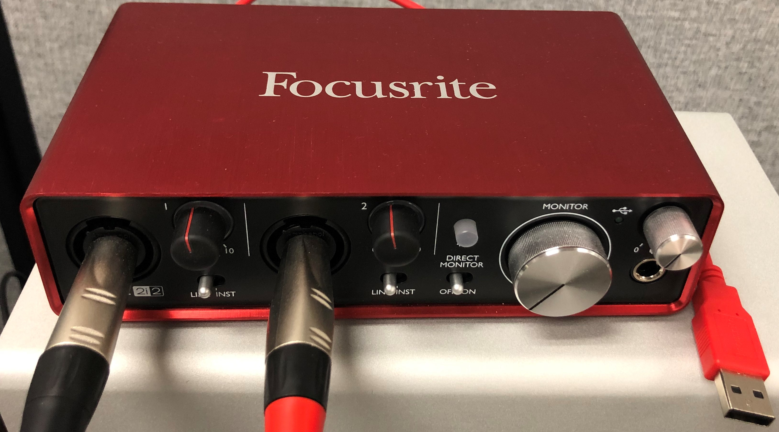
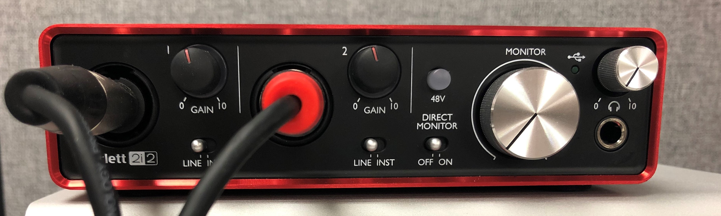
Tascam CD-A580 + Focusrite + cable

Slide 66
Tascam ¼” 2-Track Recorder (BR-20) reel-to-reel player
RCA to ¼” cable to connect the Tascam outputs to the Focusrite inputs
Use with the Focusrite interface
Two speeds, high and low (7.5 and 3.75 IPS)
Use an empty take-up reel while recording

Slide 67
Tascam ¼” 2-Track Recorder (BR-20) reel-to-reel player
front
back

Slide 68
Reel-to-reel Track Formats: Half-Track Stereo (2-track stereo)
https://www.youtube.com/watch?v=zxEgS8V8-ho

Slide 69
Quarter-Track and Monoaural
Mono-track as compared to Half-Track
Quarter-track creates two sets of stereo/dual mono tracks – one pair on each “side” of a ¼” tape, essentially 4 tracks but used in pairs as opposed to all 4 tracks in one direction.
L
R

Slide 70
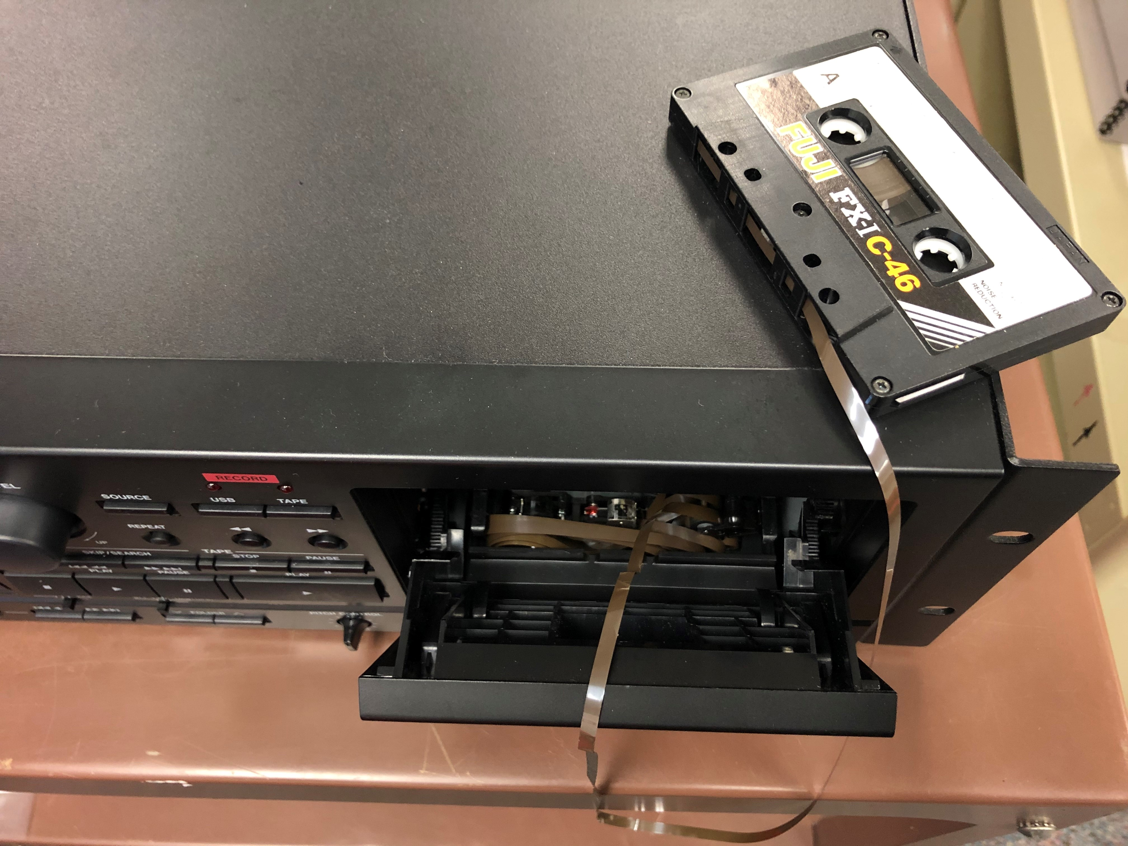
Tape repair

Slide 71
Audacity software open source, free

Slide 72
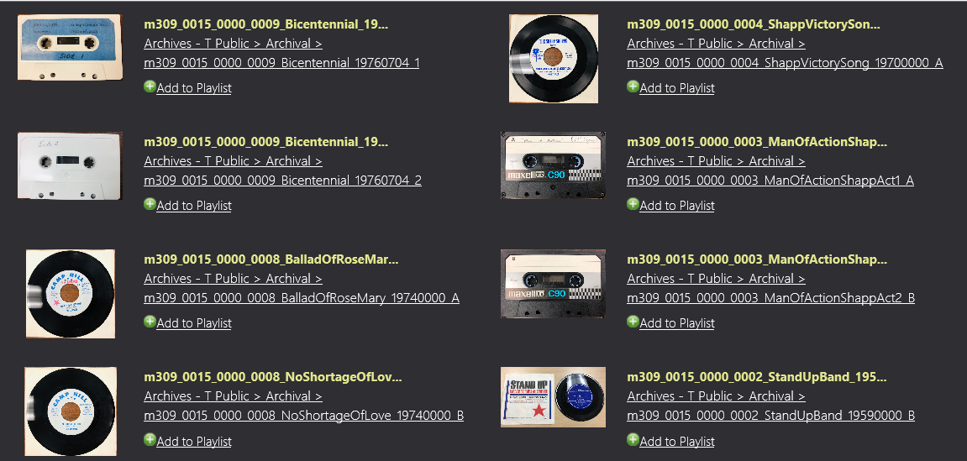
Ingesting into VideoBank

Slide 73
Processing descriptive metadata in VideoBank

Slide 74
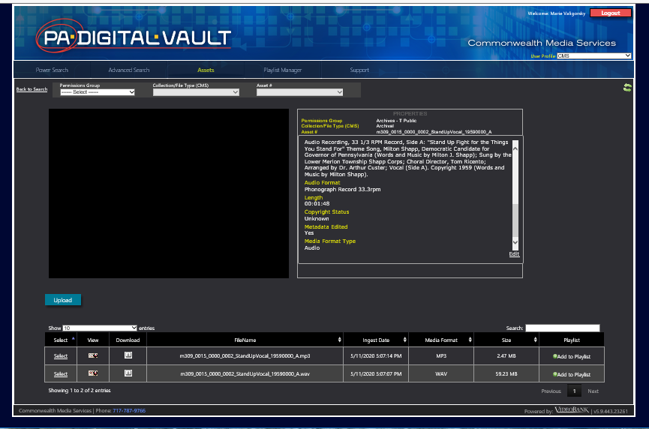
Processing descriptive metadata in VideoBank

Slide 75
Thank you! Email: mvaligorsk@pa.gov
Resources:
ARSC Guide to Audio Preservation https://clir.wordpress.clir.org/wp-content/uploads/sites/6/pub164.pdf
ARSC Audiotape Tutorial: Common Track Formats for Quarter-Inch Magnetic Tape
https://www.youtube.com/watch?v=zxEgS8V8-ho
AVCC at AVPreserve
https://www.weareavp.com/products/avcc
Audacity
https://www.audacityteam.org/

Slide 76
Questions & Comments

Slide 77
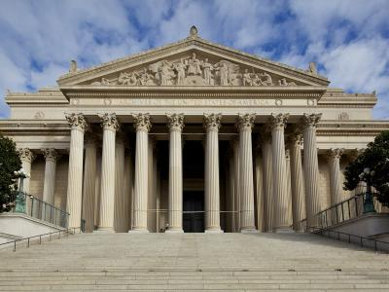
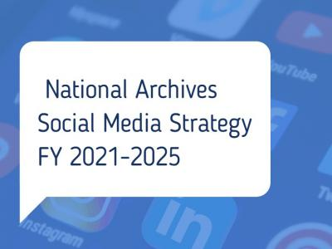
News from NARA
https://www.archives.gov/news

Slide 78
Upcoming Webinars
State Electronic Records Initiative (SERI) Webinar
October 13: Home is Where the Records Are: Managing Records in a Teleworking World
For registration: https://www.statearchivists.org/programs/state-electronic-records-initiative/seri-webinars/
CoSA Member Webinars
October 22: State Archives Showcase - California & Louisiana
November 19: State Archives Showcase - Utah & District of Columbia
For registration: https://www.statearchivists.org/programs/cosa-webinar-series/

Slide 79
2020 Electronic Records Day October 9, 2020

Slide 80
Webinar Evaluation
We really do appreciate your feedback!
When you exit the webinar, you will automatically be taken to an online webinar evaluation. Please take a few minutes to complete the survey and help us plan future webinars.

